Slide 1
Thanks a lot for your participation!!! ☺
Here is the last question for you.
Could you let us know if you saw the group motion of the disks or not?
Please proceed to the next slides to see the examples ;)
(In main_3disk_nonret and main_3disk_ret conditions)

Slide 2
Group Motion: Three disks are moving left-and-right in concert

Slide 3
Element Motion: two disks in the middle are flickering and the third disk is jumping from left to right

Slide 4
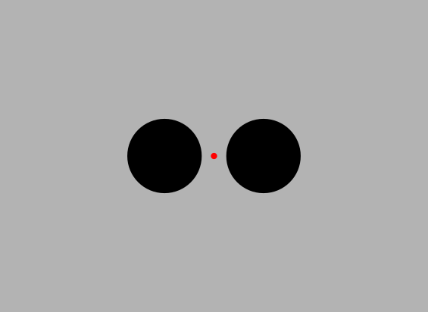
Which disk-motion did you perceive (1-5 scale)?
1
2
3
4
5
Element motion
Group motion
Jump left-right
Move left-right altogether

